Slide 1
BLOCKCHAIN BASED SECURE BILLING FOR HOSPITALS

Slide 2
Group Members:-
Ashish Hanmant Mahadik (23055)
Manish Prakash Jadhav (23043)
Omkar Ganpat Sonawale (23047)
Sourabh Vishnu Jamdade (23052)

Slide 3
PROBLEM STATEMENT Develop a better and improved software than current Hospital Billing System that solves problems in field of security to avoid ongoing frauds in medicine sector. It is very important to maintain and handle important financial information of a hospital in a secure way. The new system will provide a secure platform for hospital bill management by using a very secure blockchain hashing mechanism

Slide 4
OBJECTIVES
Blockchain is a system of recording information in a way that makes it difficult or impossible to change, hack, or cheat the system, and will help us to achieve a better security than current available medical billing systems.
The purpose of the project is to build an application program to reduce the manual work and increase the speed and security for managing the Bills. It tracks and stores the medical data in more secure way.
They may use improper medical billing to generate more profit. Often, hospitals that engage in medical billing fraud don’t stop at just one they typically commit some combination of fraud practices.
These frauds are increasing, our goal is to make a fully secure medical billing system which will stop these frauds as it is roots.

Slide 5
SOFTWARE AND HARDWARE REQUIRMENT
Software Requirements:
• Operating System: Windows 7, Linux, Mac OS.
• Front End: Python, Tkinter.
• Back End: MYSQL connector, Python IDE
• Tool: VS Code. 3.2
Hardware Requirements:
• System: Pentium IV 2.80 GHz, Core
• Hard Disk: 160 GB.
• Monitor: 15 VGA Colour.
• Ram: 4 GB.

Slide 6
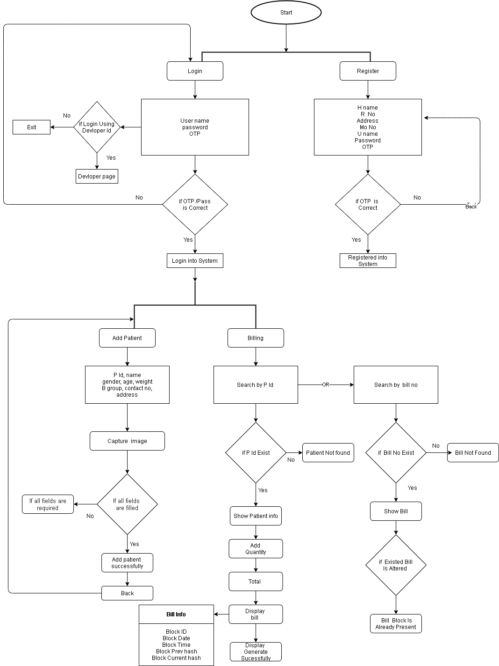
FLOW CHART
USER SIDE:

Slide 7
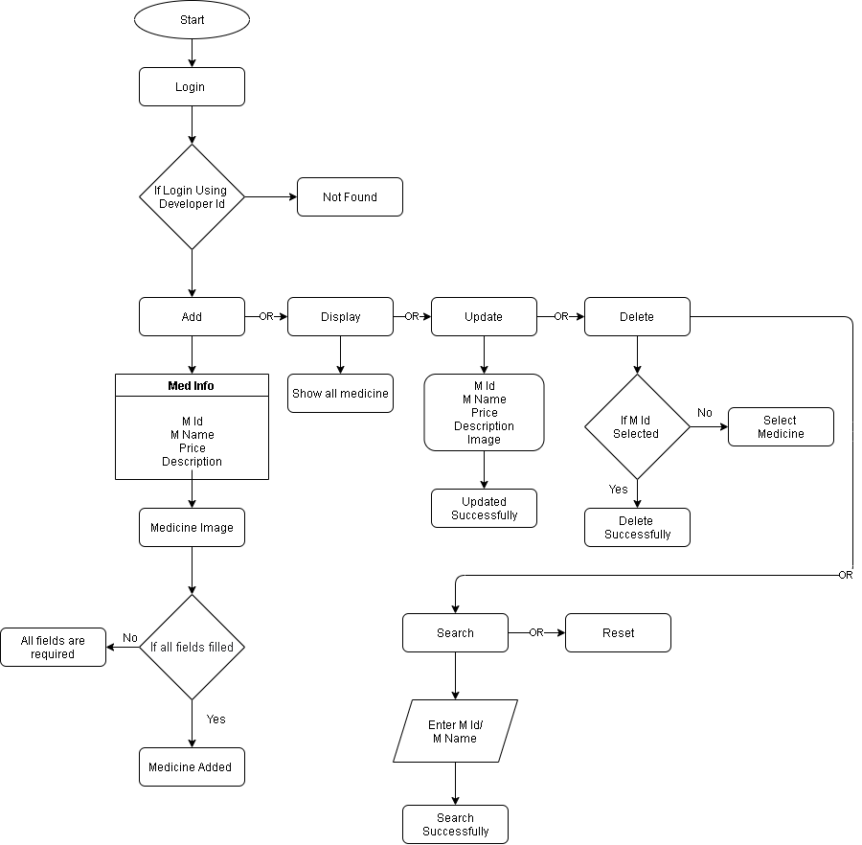
DEVELOPER SIDE:

Slide 8
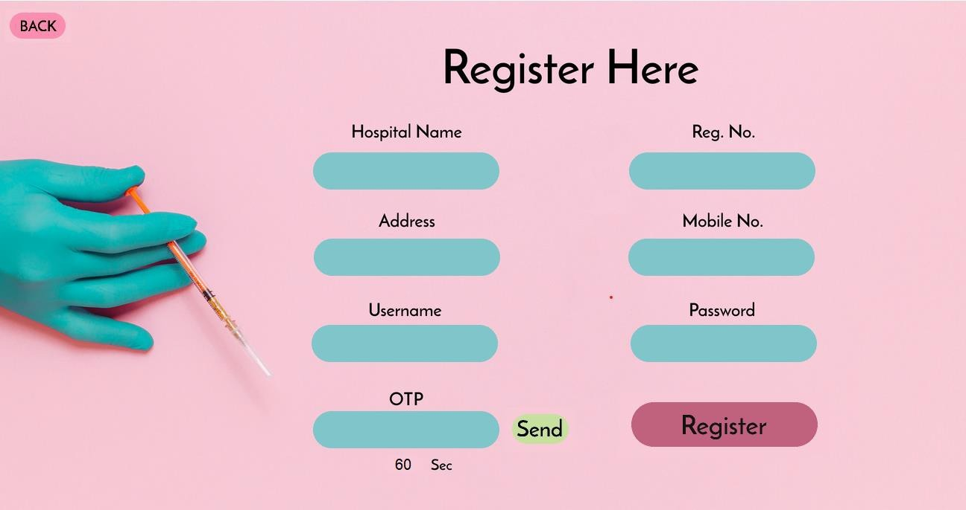
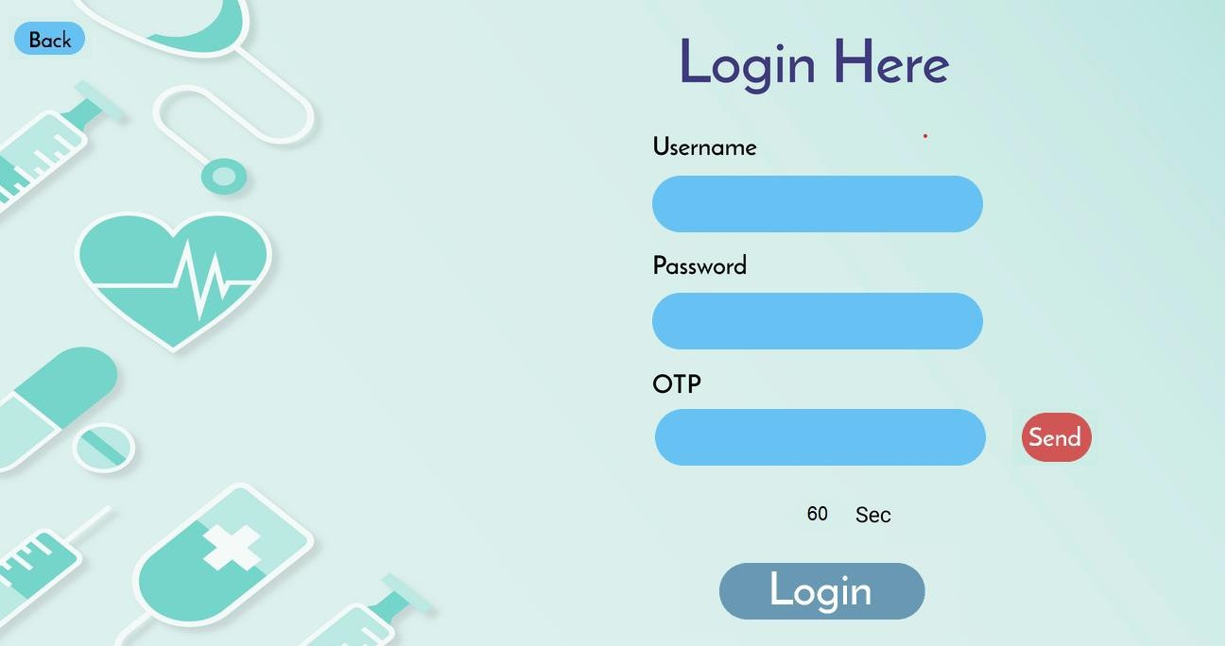
MODULES AND THEIR FUNCTIONALITIES
REGISTRATION MODULE LOGIN MODULE
Registration module designed for new user, where new hospital can register and setup there individual billing system. Register module is kept convenient for new users and only essential information is taken.
Login module is developed for existing users where registered user can login to their individual billing system profile where they can manage their hospital billing system.

Slide 9
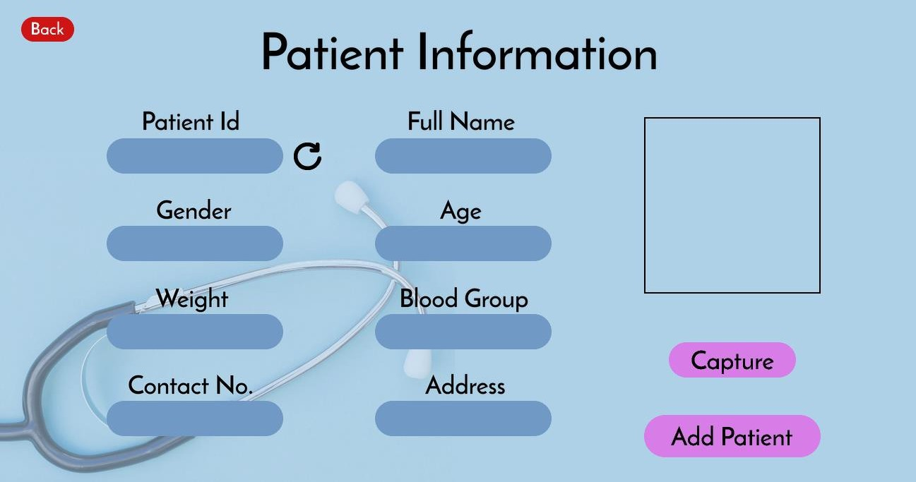

ADD PATIENT MODULE WEBCAM MODULE
It is an easy way to keeping records of new patients and for that task multiple fields are asked, which are Patient Id, Full Name, Gender, Age, Weight, Blood Group, Contact No, Address and at last its Patient’s image. All the required field are necessary and important so they properly and safely kept in database.
This module is used to capture the live image of patient so that we can use it for further uses.

Slide 10
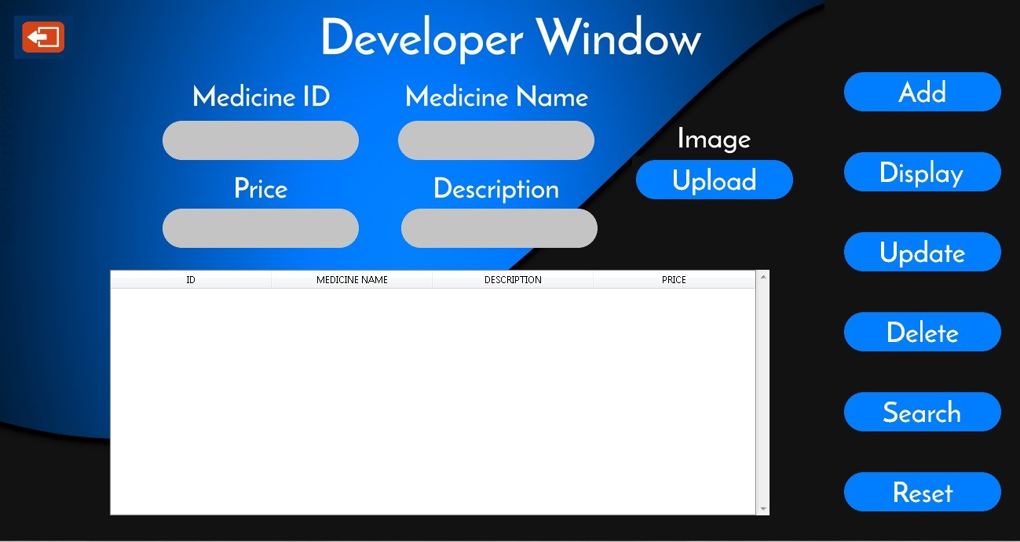
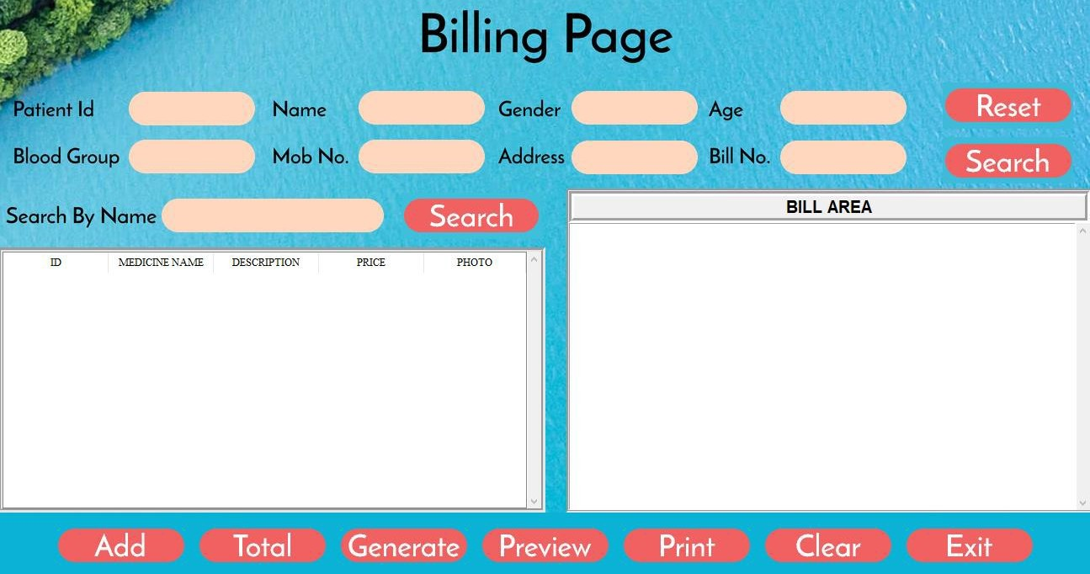
DEVELOPER WINDOW BILLING WINDOW
Developer module is the only side of project that can manage all the database of the project. Developer module is a well interpretation of database workstation. It is developed with a user-friendly UI where all the medicine related data can be added, deleted and replace.
This is the very important part of the system and it is developed with our focused blockchain technology to provide maximum security.

Slide 11
CONCLUSION
We have studied new technologies like python and blockchain while working on this project.
This represents a typical real-world situation. Scheduling a project and adhering to that schedule creates a strong sense of time management.
Sense of teamwork has developed and confidence of handling real life project has increased to a great extent.
Initially, there were problem with the validation but with discussions, we were to implement validations Our understanding of database design has been strengthened this is because in order to generate the final reports of database designing has to be properly followed.
By using the blockchain technology, we have implemented the immutable patient billing information.
For implementing blockchain concept, we have used and implement SHA 256 for securing the billing system.

Slide 12
FUTURE SCOPE
• Diagnostics billing system.
• Creating patient’s report card.
• Generating blockchain visually.
• Securing patient’s information using blockchain.

Slide 13
REFERENCES
• Bitcoin: A Peer-to-Peer Electronic Cash System white paper by Satoshi Nakamoto.
• https://www.figma.com with https://github.com/Proxlight/Proxlight- Designer.
• https://dev.mysql.com/doc/refman/8.0/en/
• https://pypi.org/project
• Core Python Programming - Covers Fundamentals to Advanced Topics By Dr.Rao R. Nageswara

Slide 14
Thank You

